Slide 1
Human Computer Interaction - ISAD254SL
Group members -batch 19.2
10707417 - H.J.K.I.Wijerama
10707129 - K.L.D.Anupama
10707274 - P.Y S.D.S. Manawadu
10707256 - N.N.D.G Liyanage
10713401 - U.R.K.Ukwatta
10707216 - K.C.Heshan

Slide 2
Class activity 1/2/2021
Attractive User Interfaces

Slide 3
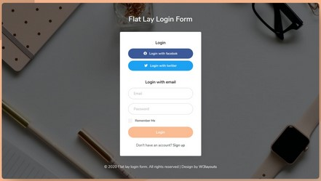
User interface - example 01
This is the login interface.
we can see this user interface use some methods to get user attention.
use diffrent colours to login buttons; (login with twitter , login with face book)
use eye comfortable colours to get user attention.
This interface use diffrent size fonts according to the pirority,

Slide 4
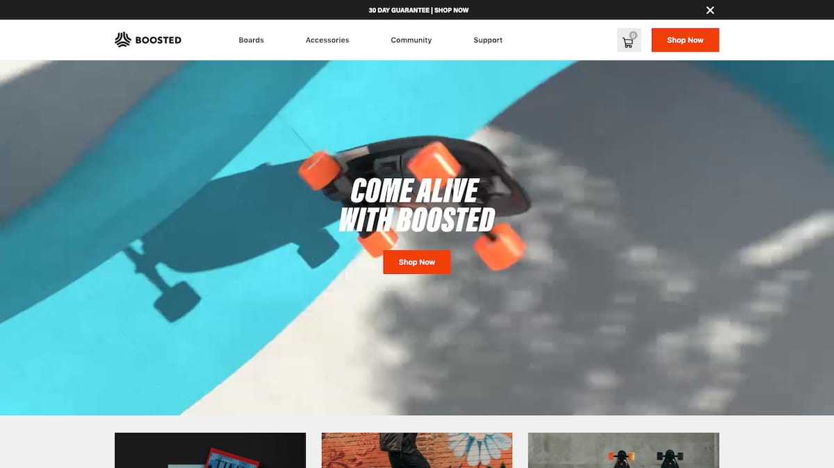
User Interface - example 02
Now this is a website with personality. Upon arrival, users are immediately greeted with an explosive, fun-filled, dynamic video of the product in use.
And then we notice the “Shop Now” call-to-action, sitting patiently right at the center of your screen.
The interface is stripped of color but for the luminous orange wheels of the board, and uI IS delivered only the most relevant information: image, top speed, range, price, shipping time, and, of course, “Buy Now”.

Slide 5
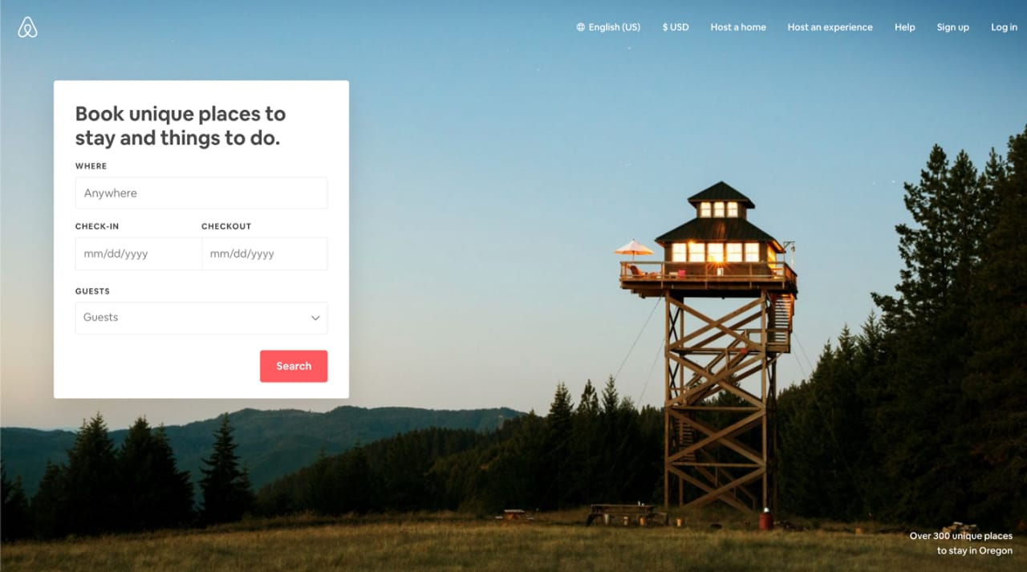
User Interface - example 03
This interface if used to booking places.
This UI is design to get user attention.
There is a search button in red colour to get user attention.
And the background image is suitable
The login form is in left corner to highlight to the user.

